Slide 1

ACCIDENT DETECTION USING VEHICULAR ADHOC NETWORK
Guided By :
Prof.Jisha P Abraham
Presented By GROUP 1 :
Aathik TR - 1
Arjun P Bhaskar - 11
Reshma Revi - 42

Slide 2
INTRODUCTION
VANET, or Vehicular AdHoc Network, is an application of MANET (Mobile AdHoc Network)
Vehicles in the network communicate during the event of an accident to any of their peers

Slide 3
PROBLEM STATEMENT
Chances of saving precious human lives during the course of an unfortunate accident are diminishing.
The time taken for vital assistance to get notified about an accident can determine the chances of survival of the victims.

Slide 4
PROPOSED SYSTEM
Sensing of an accident using a combination of multiple sensors
Transmission of data efficiently using VANET principle
Processing of incoming data at the central hub
Classification of accidents based on their severity using Machine Learning
Informing concerned authorities and organisations, providing information such as shortest distance to accident spot

Slide 5
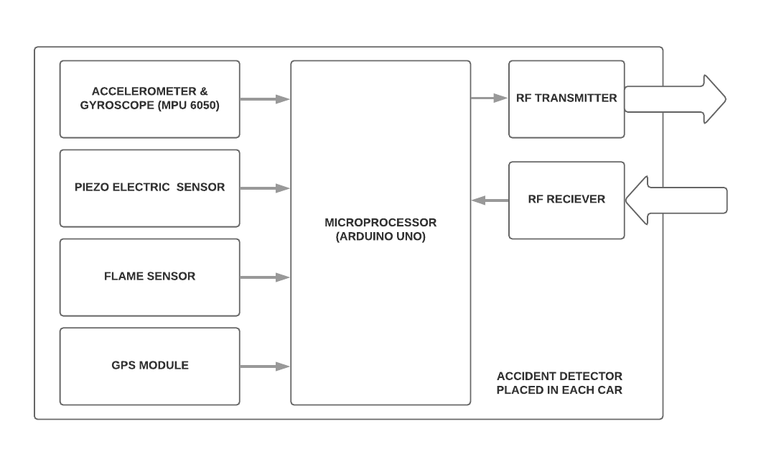
ARCHITECTURE
Figure : Accident Detection within the affected vehicle

Slide 6
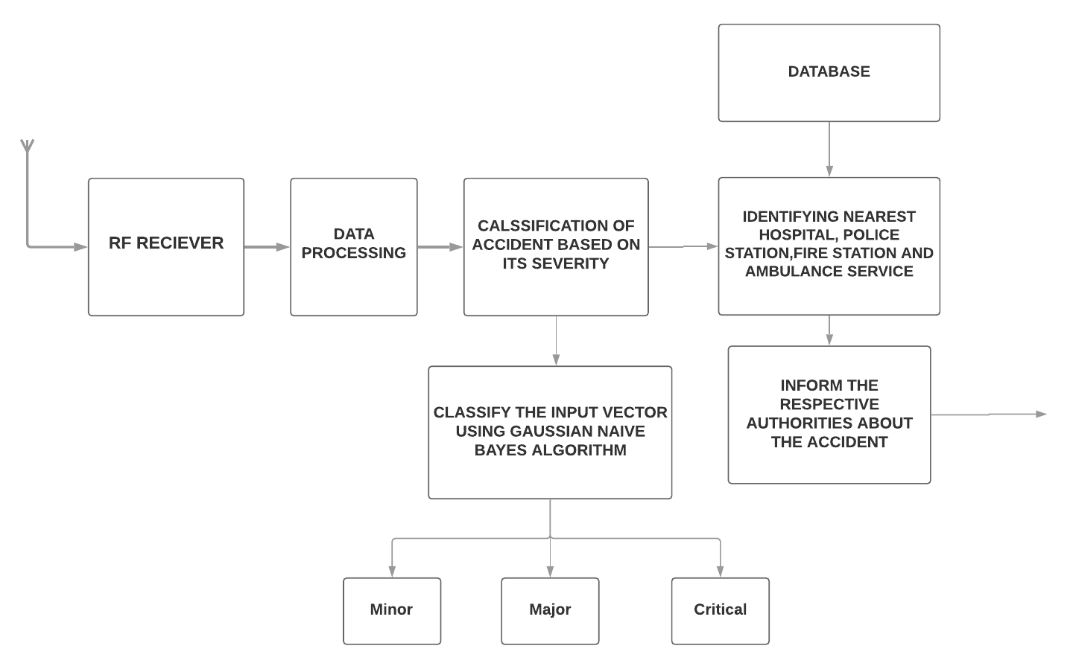
ARCHITECTURE (cont’d)
Figure : Intervehicular Communication (From site of accident to the central hub)

Slide 7
IMPLEMENTATION
Within The Vehicle :
Microprocessor - Arduino UNO (inside each node, i.e, vehicle)
Sensors -
Accelerometer & Gyroscope (MPU 6050)
IR Fire Sensor
Piezoelectric Sensor (Flexi-Force A301)
GPS module (NEO 6M GPS Module)
RF Transmitter and receiver (433 MHz)

Slide 8
IMPLEMENTATION
Outside the Vehicle :
Central Hub
Classification of accidents based on severity.
Using the pre-trained Naive Bayes algorithm we classify accident based on the received data.
Finding nearest hospital, police station, fire station and ambulance service.
Informing the nearest medical centre to the accident spot, and other required personnel.

Slide 9
IMPLEMENTATION
How is the data classified ?
The machine learning classification technique called ‘Gaussian Naive Bayes’
It is implemented using SciKit library in Python, which classifies data in the online database made in Xampp
The three class labels are : minor, major and critical

Slide 10
IMPLEMENTATION
Identifying nearest hospital, police station, etc :
The ‘Haversine formula’ is used to calculate distance between two coordinates on a sphere
Using the formula the distances to all organisations stored in the database from the accident spot is calculated as follows :

Slide 11
OUTPUT
Obtaining analog data from the various sensors placed at particular positions in the nodes
Transmitting data including location and other parameters efficiently
Classification of accidents into minor, major and critical
SMS received at nearest hospital, police station and fire station (only in the event of a fire detected), informing about the severity of the accident and location
Mail sent to nearest ambulance service specifying the shortest route to the accident spot.

Slide 12
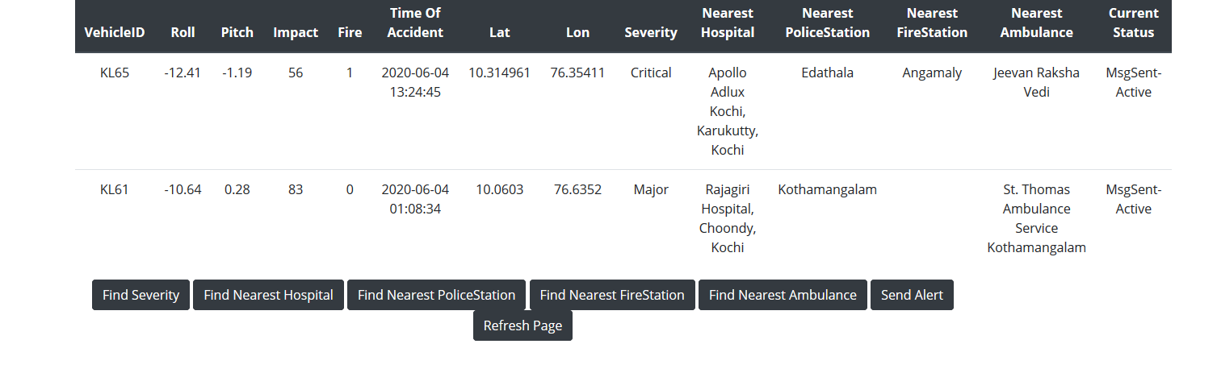
OUTPUT
Figure : Database Values, after classification and identifying nearest authorities and organisations

Slide 13
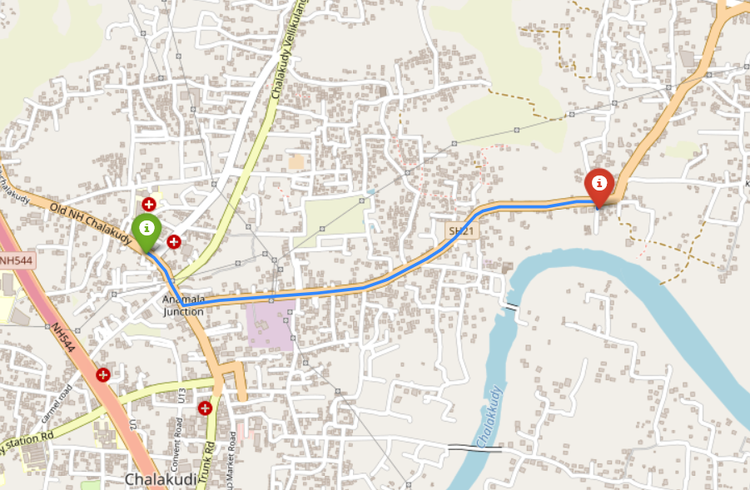
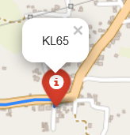
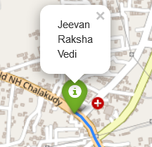
OUTPUT
NEAREST AMBULANCE SERVICE IDENTIFIED
ACCIDENT SPOT
Figure : Map showing the shortest route to the accident spot, as mailed to the ambulance service

Slide 14
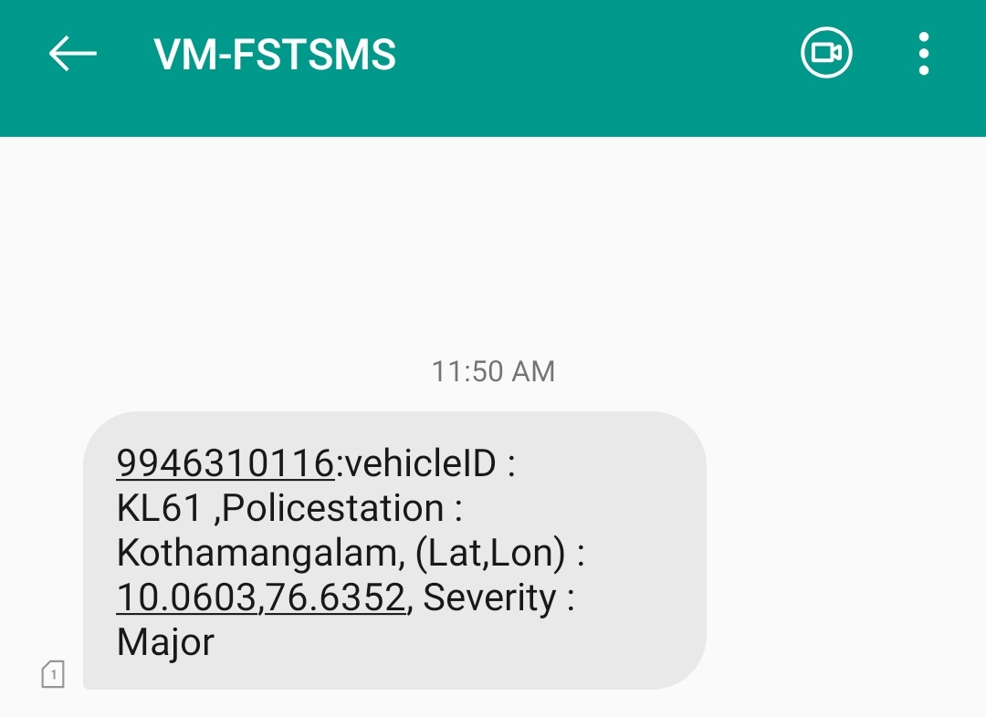
OUTPUT
Figure : Message received at the nearest identified police station to the accident spot

Slide 15
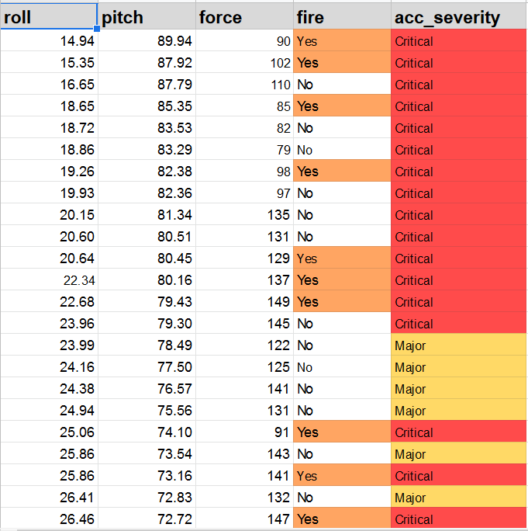
DATASET
Figure: A portion of dataset used for training

Slide 16
RESULT
An accurate system which detects accidents using many parameters being monitored continuously
A system which accurately classifies accidents based on severity and finds nearest organisations such as hospital, ambulance service,etc
A system which can efficiently reduce the chances of accidents not being spotted, and decrease the response time of important life-saving authorities

Slide 17
THANK YOU

